Slide 1

AY-2025-2026
ODD SEM
Department of ECE
Analog electronic Circuit Design
23ec2104
Topic:
STABILITY FACTOR OF BJT BIAS
Session - 06

Slide 2
Session content
Stability Factor
Stability Factor for Fixed Bias
Stability Factor for Collector Feedback Bias
Stability Factor for Voltage Divider Bias

Slide 3



AIM OF THE SESSION
To compare stability of various biasing circuits for BJT
INSTRUCTIONAL OBJECTIVES
This Session is designed to:
  Demonstrate stability factor
  Compare stability of various biasing circuits
LEARNING OUTCOMES
At the end of this session, you should be able to:
  Derive stability factor for BJT
  Select biasing circuit based on stability factor

Slide 4
REVISIT Biasing of BJT
Biasing refers to the application of D.C. voltages to setup the operating point in such a way that output signal is undistorted throughout the whole operation.
Also once selected properly, the Q point should not shift because of change of I_{C} due to
β variation due to replacement of the transistor of same type
Temperature variation
Stabilization
The process of making operating point independent of temperature changes or variation in transistor parameters is known as stabilization.
Stabilization of operating point is necessary due to
Temperature dependence of I_{C}
Individual variations
Thermal runaway
2

Slide 5
Stabilization
Temperature dependence of I_{C} & Thermal runaway
I_{C} = βI_{B} + (β +1)I_{CBO}
I_{CBO} is strong function of temperature. A rise of 10ºC doubles the I_{CBO} and I_{C} will increase ( β+1) times of I_{CBO}
The flow of I_{C} produce heat within the transistor and raises the transistor temperature further and therefore, further increase in I_{CBO}
This effect is cumulative and in few seconds, the I_{C} may become large enough to burn out the transistor.
The self destruction of an unstablized transistor is known as thermal runaway.
Stability Factor
The rate of change collector current I_{C} with respect to the collector leakage current I_{CBO} is called stability factor, denoted by S.
dI
C
S = ( )
Lower the value of S, better is the stability of the transistor.
^{dI}CBO
3

Slide 6
Stability Factor
I_{C} = βI_{B} + (β +1)I_{CBO}
(1)
Differentiating equation (1) w.r.t I_{C}
( β + 1)
dI dI dI_{B}
(β +1)
S =
1 = ( ^{B} ) + ( +1)
1 = ( ) +
d I
CBO
1 − ( )
B
dI_{C}
dI_{C} dI_{C}
S
d I _{C}
The rate of change collector current I_{C} with respect to the collector leakage current I_{CBO} at constant β and I_{B} is called stability factor, denoted by S.
Different biasing schemes
Fixed bias (base resistor biasing)
Collector Feedback bias
Voltage divider bias
4

Slide 7
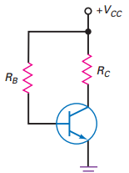
Stability factor for Fixed Bias
Using KVL in the base-emitter loop V_{CC} – I_{B}R_{B} –V_{BE} = 0 ; I_{B} = (V_{CC}-V_{BE})/R_{B}
I_{C} = βI_{B}= β(V_{CC}-V_{BE})/R_{B}
Using KVL in the collector-emitter loop V_{CC} – I_{C}R_{C} –V_{CE} = 0; V_{CE} = V_{CC} - I_{C}R_{C}
Q(V_{CE},I_{C}) is set
Fig. 6.1. Fixed Bias
5

Slide 8
Stability factor for Fixed Bias
Advantages:
Operating point can be shifted easily anywhere in the active region by merely changing the base resistor (R_{B}).
A very small number of components are required.
Disadvantages:
Poor stabilization
High stability factor(S=β+1 because I_{B} is constant so dI_{B}/dI_{C} =0 ), hence prone to thermal runaway
Usage:
Due to the above inherent drawbacks, fixed bias is rarely used in linear circuits (i.e., those circuits which use the transistor as a current source). Instead, it is often used in circuits where transistor is used as a switch.
How the Q point is affected by changes in V_{BE} and I_{CBO} in fixed bias?
I_{B} = (V_{CC}-V_{BE})/R_{B} I_{C} = βI_{B}

Slide 9
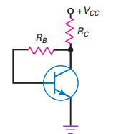
Stability factor for Collector feedback Bias
V_{CC} = (I_{C}+I_{B})R_{C} + V_{CE}
(1)
^{V}CE
= I_{B}R_{B} + V_{BE} (2)
Since, I_{C} = βI_{B} so from equation (1) & (2)
V − V
I =
CC BE
Q(V ,I ) is set
B
R + (1 + β ) R
CE C
B
C
Fig. 5.2. Collector Feedback Bias

Slide 10
Stability factor for Collector feedback Bias
Advantages:
Better stabilization compared to fixed bias
Disadvantages:
This circuit provides negative feedback which reduces the gain of the amplifier.
Usage:
The feedback also decreases the input impedance of the amplifier as seen from the base, which can be advantageous. Due to the gain reduction from feedback, this biasing form is used only when the trade-off for stability is warranted.
How the bias stability is improved in collector base bias?
If I_{C} becomes larger than design value, it causes an increase voltage drop across R_{C} hence smaller value of V_{CE} which in turn causes I_{B} to be smaller than its design value. Since I_{C} = βI_{B} thus I_{C} will also tend to be reduced towards its original value.
For bais Stabilization : R_{B}<< βR_{C}
^{V} CC
V _{BE}
V − V
I = β [
If R_{B}<< βR_{C}
I =
CC BE
C
R + (1 + β ) R ]
C
R
B
C
C
8

Slide 11
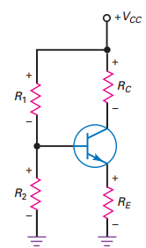
Stability factor for Voltage Divider Bias
^{V}Th ^{= I}B^{R}Th
V_{BE} −(I_{B} + I_{C} )R_{E}
dI_{B}
R_{E}
dI
dI
= −
0 = R_{Th} (
B
) + (1+
B
)R
dI
R_{Th} + R_{E}
dI
dI
E
C
C
C
R
(1 + ^{Th} )
( R_{Th} + R _{E} )
R _{E} ( β + 1) + R_{Th} ( β
R
S = ( β + 1)
S = ( β + 1)
E
R
+ 1) +
Th
R _{E}
For stability, S should be small which can be achieved by making R_{Th}/R_{E} small. For very small R_{Th}/R_{E} ; S = 1 (ideal case)
Fig. 6.3. Voltage divider bias for BJT
For very small R_{Th}/R_{E} : R₂ current drawan by R₂ will be large.
^{R}Th
R_{E} Large V_{cc} required. Hence comproise is made in selection.

Slide 12
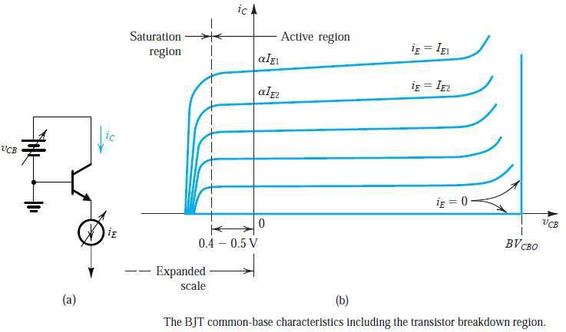
Transistor Breakdown and Temperature Effects

Slide 13
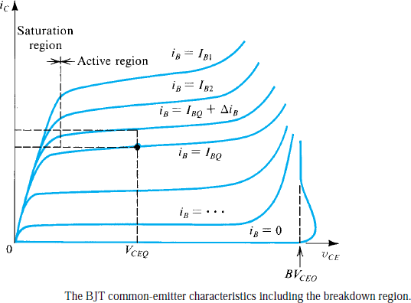
Transistor Breakdown and Temperature Effects

Slide 14
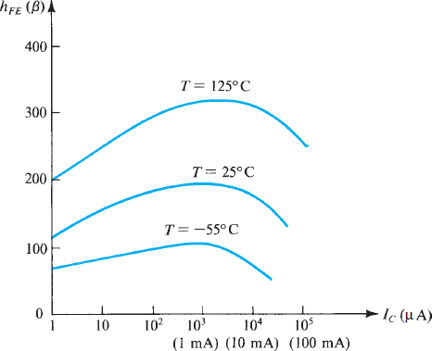
Transistor Breakdown and Temperature Effects
Typical dependence of β on IC and
on temperature in an integrated-
circuit intended mA.
npn silcon transistor
for operation around 1

Slide 15
Example Problems
6.1. Compare the stability factors for fixed bias, collector feedback bias and voltage divider bias for BJT
Solution:
S= 1+ β for fixed bias.
S = 1 could be achieved with collector feed back bias at the cost of reducing R_{B} which draw more base current which causes less battery life for V_{CC}
S=1 could be achieved with voltage divide bias at increase input current or increase supply voltage.

Slide 16

SELF-ASSESSMENT QUESTIONS
Which Bias more thermally stable?
Emitter Bias
Base Bias
Collector feedback Bias
Voltage divider bias
Which of the following bias is less effected by temperature variation?
Voltage divider bias
Collector feedback bias

Slide 17
SELF-ASSESSMENT QUESTIONS
3. Which of the following is ideal stability factor for BJT?
1
1+β
zero
β
4. Which of the following is the smallest realizable stability factor?
1
1+β
zero
β

Slide 18
ANSWERS
D
A
C
A

Slide 19
TERMINAL QUESTIONS
Obtain the expression for stability factor of BJT with respect to reverse saturation current.
Obtain the stability factor for Fixed bias of BJT.
Obtain the stability factor for Collector feedback bias of BJT.
Obtain the stability factor for voltage divider bias of BJT.
Compare stability of fixed bias and voltage divider bias.

Slide 20
REFERENCES FOR FURTHER LEARNING OF THE SESSION
Reference Book:
Robert L. Boylestad and Louis Nashelsky - “Electronic Devices and Circuit Theory”

Slide 21
THANK YOU
Team – Analog electronic Circuit Design
Prepared by – Dr. M. Siva Kumar

